Slide 1

Introduction to LangChain

Slide 2
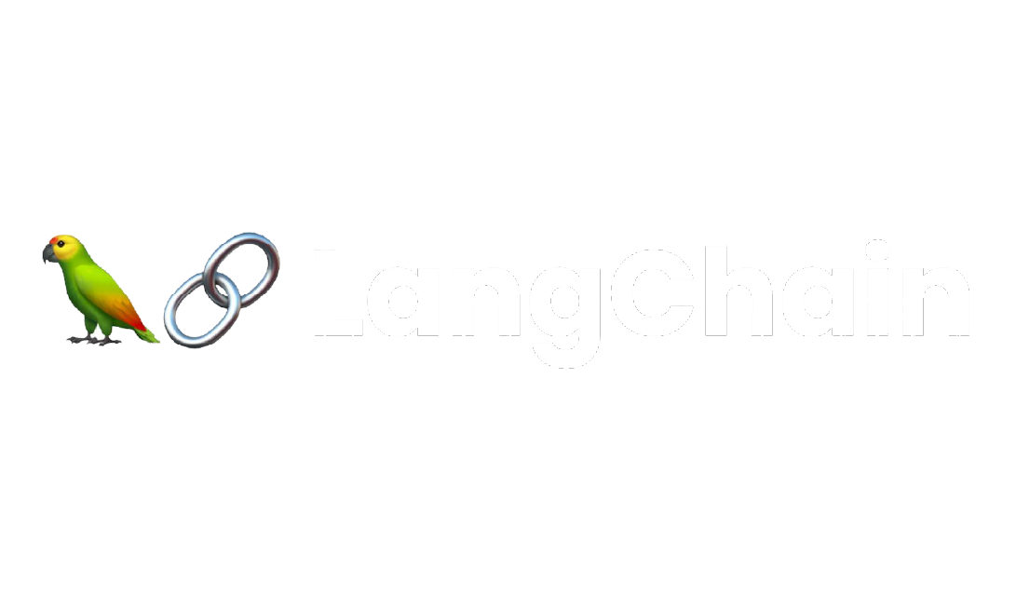

What is LangChain
An open framework & ecosystem to develop applications powered by LLMs using a suite of tools

Slide 3
What is LangChain
Its core framework consists of libraries to connect with LLMs using prompts and format outputs using output parsers.
Multiple steps can be chained and complex conversational applications, RAG systems, and agents can be built.

Slide 4
What is LangChain
LangChain features LangServe and LangSmith for deploying, evaluating, and monitoring LLMs.
LangChain includes LangGraph, which allows for combining multiple chains to build complex agents and more.

Slide 5
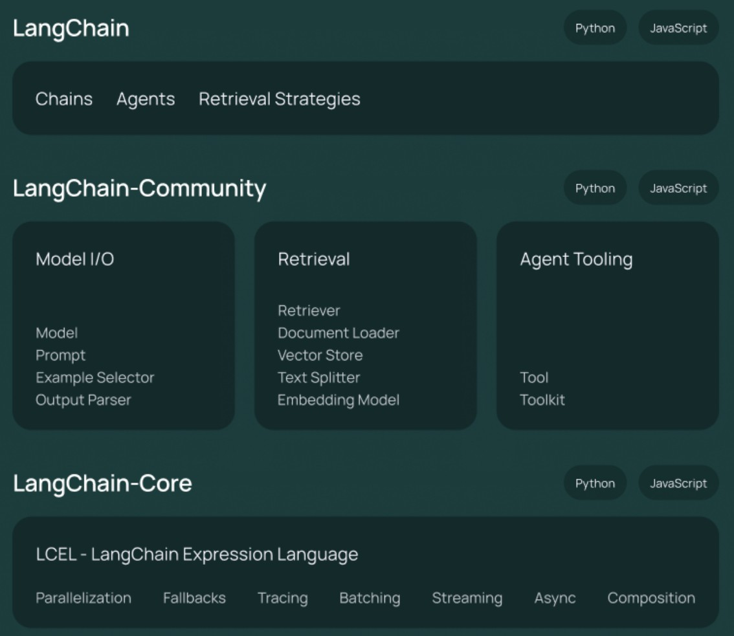
LangChain Core Framework
It is a framework that gives developers and data scientists a suite of components to build LLM applications easily.
As the name suggests, one can easily chain multiple operations together to build simple as well as complex conversational LLM applications.
Compatible with almost all popular large language models.

Slide 6
LLM Input/Output with LangChain
langchain-openai
langchain-google-genai langchain-aws
langchain-google-vertexai langchain-anthropic
langchain-community
LangChain has a community library which is a one-stop shop to connect with all open LLMs including popular models hosted on HuggingFace, Vector DBs and more
LangChain has the necessary libraries and functions to connect with all major closed LLMs like ChatGPT, Gemini, Claude and popular models from cloud providers.

Slide 7
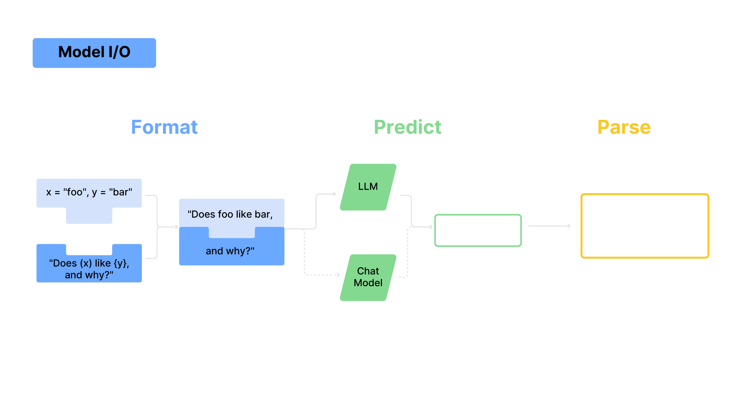
LLM Input/Output with LangChain

Slide 8
LangChain provides interfaces to talk to LLMs using its popular ChatModel construct and predict responses based on input prompts
LLM
Input/Output with LangChain
Constructs like PromptTemplate and ChatPromptTemplate allow for dynamic, data- driven prompt formatting and creation at runtime.

Slide 9
Allows access to output parsers to parse LLM responses into formats like JSON, CSV, and more
LLM
Input/Output with LangChain
Enables us to do iterative prompt engineering easily

Slide 10
Many enterprise applications use LLMs to access custom enterprise data for answering questions beyond their original training data.
Why Retrieval with LangChain

Slide 11
Retrieval Augmented Generation (RAG) System
A system which integrates custom data and augments an LLM’s knowledge-base to generate contextual responses

Slide 12
LangChain helps in building both the retrieval and the response generation pipeline
Why Retrieval with LangChain

Slide 13
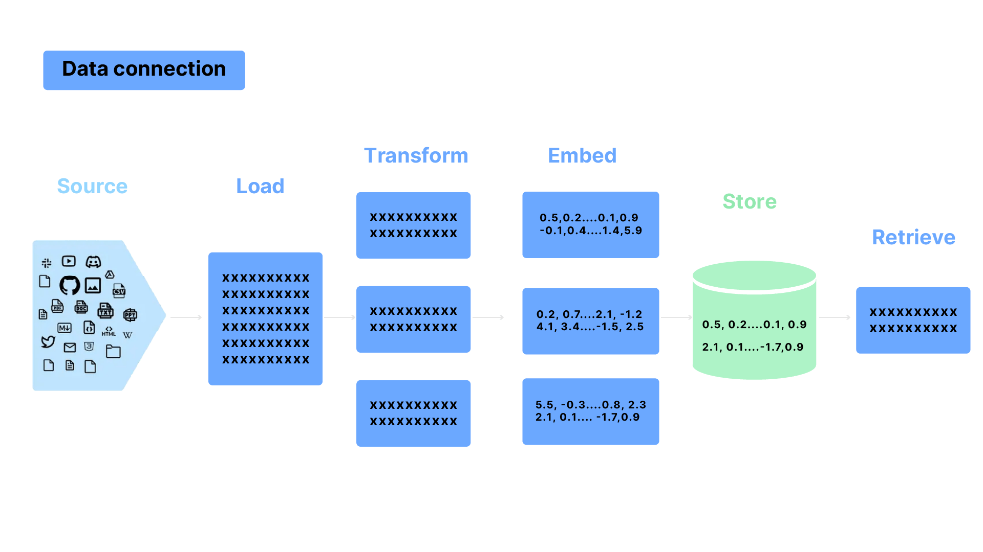
Retrieval with LangChain

Slide 14
LangChain provides over 100 different document loaders:
as well as integrations with other major providers like Unstructured to load data from all types of documents (HTML, PDF, code)
Retrieval with LangChain
Provides several transformation algorithms:
to split, chunk and transform larger documents into more manageable chunks for retrieval

Slide 15


Retrieval with LangChain
Offers integrations with more than 25 embedding model providers:
ranging from open-source solutions like HuggingFace to proprietary ones like OpenAI
enabling the embedding of document chunks into vector embeddings.

Slide 16
Integrates with over 50 vector database providers:
to store document chunks and embeddings.
Retrieval with LangChain
Supports many different retrieval and search algorithms:
to retrieve relevant document chunks based on user queries

Slide 17

Tools and Agents with LangChain
Model
Thought
Agent (bot)
"I need to find each country in the world and add them together"
How many countries are there in the world?
There are 195 countries in the world
Observations
SERP API
(real-time API access to Google Search results)
Tool
Search / Action

Slide 18
LangChain enables to build tools that give an interface for LLMs and other components to interact with other systems
Example tools include Wikipedia, calculator, search engines, and more
Tools and Agents with LangChain
Allows for the creation of agents that use LLMs to determine actions, which are executed using various tools.
An executor serves as the runtime environment that facilitates the execution of these agents.

Slide 19
Building Chains with LangChain
Chain 1
Chain 2
Output of Chain 1
Input
to Chain 2
Input
=
Output

Slide 20
LangChain allows the use of chains, which are sequences of calls or execution steps.
These calls can be made to an LLM, a tool, or a data preprocessing step.
Building Chains with LangChain

Slide 21
Legacy Chains
These are derived classes constructed by subclassing a legacy Chain class These chains do not use LCEL under the hood but are the standalone classes
LangChain supports two major types of chains:
Building Chains with LangChain
LCEL Chains
It uses the newer LangChain Expression Language (LCEL) to build a chain of steps by using the overloaded vertical bar or pipe ‘|’ operator

Slide 22
Enables to connect to almost any third-party LLM, Vector DB, Embedding models, and Data loaders
Supports storing LLM conversation history using memory constructs, either in-memory, on disk, or in a data store.
It integrates with all popular data stores for effective memory management.
Other features
Has capabilities for callbacks which are useful for logging, monitoring, streaming, and other tasks

Slide 23
Thank You

